Slide 1


LIBRARY
MANAGEMENT
SYSTEM
TRANSFORMING EDUCATION IN THE DIGITAL AGE

Slide 2


PROJECT OVERVIEWTITLE: LIBRARY MANAGEMENT SYSTEM
BRIEF DESCRIPTION OF THE PROJECT:
"A WEB-BASED APPLICATION DESIGNED TO STREAMLINE LIBRARY OPERATIONS WITH MODERN AND SLEEK DESIGN."
TECHNOLOGIES USED:
HTML, CSS, JAVASCRIPT
OBJECTIVE:
EFFICIENT MANAGEMENT OF BOOKS, MEMBERS, AND LOAN TRANSACTIONS WITH AN INTUITIVE UI.

Slide 3
KEY POINTS:
RESPONSIVE DESIGN: ADAPTABLE UI FOR MOBILE, TABLET, AND DESKTOP.
MODERN DESIGN ELEMENTS:
ANIMATED BACKGROUND WITH CSS EFFECTS.
DYNAMIC NAVIGATION MENU.
USER AND ADMIN LOGIN: ROLE-BASED LOGIN FORMS WITH INTERACTIVE DESIGN.
USER-FRIENDLY INTERFACE:
ORGANIZED SECTIONS FOR BOOK, MEMBER, AND LOAN MANAGEMENT.
INTUITIVE AND VISUALLY APPEALING LAYOUT.
FEATURES OF THE
FRONTENDTITLE:

Slide 4
IMPLEMENTATION TITLE:
TECHNOLOGY
FRONTEND TECHNOLOGY STACK
HTML:
STRUCTURED LAYOUT AND SEMANTIC ELEMENTS.
CSS:
MODERN STYLING, ANIMATIONS, AND RESPONSIVE DESIGN.
HOVER EFFECTS, GRADIENTS, AND RADIAL ANIMATIONS.
JAVASCRIPT:
DYNAMIC BEHAVIOR LIKE LOGIN FORM HANDLING.
ENHANCED INTERACTIVITY WITH EVENT-DRIVEN SCRIPTING.

Slide 5

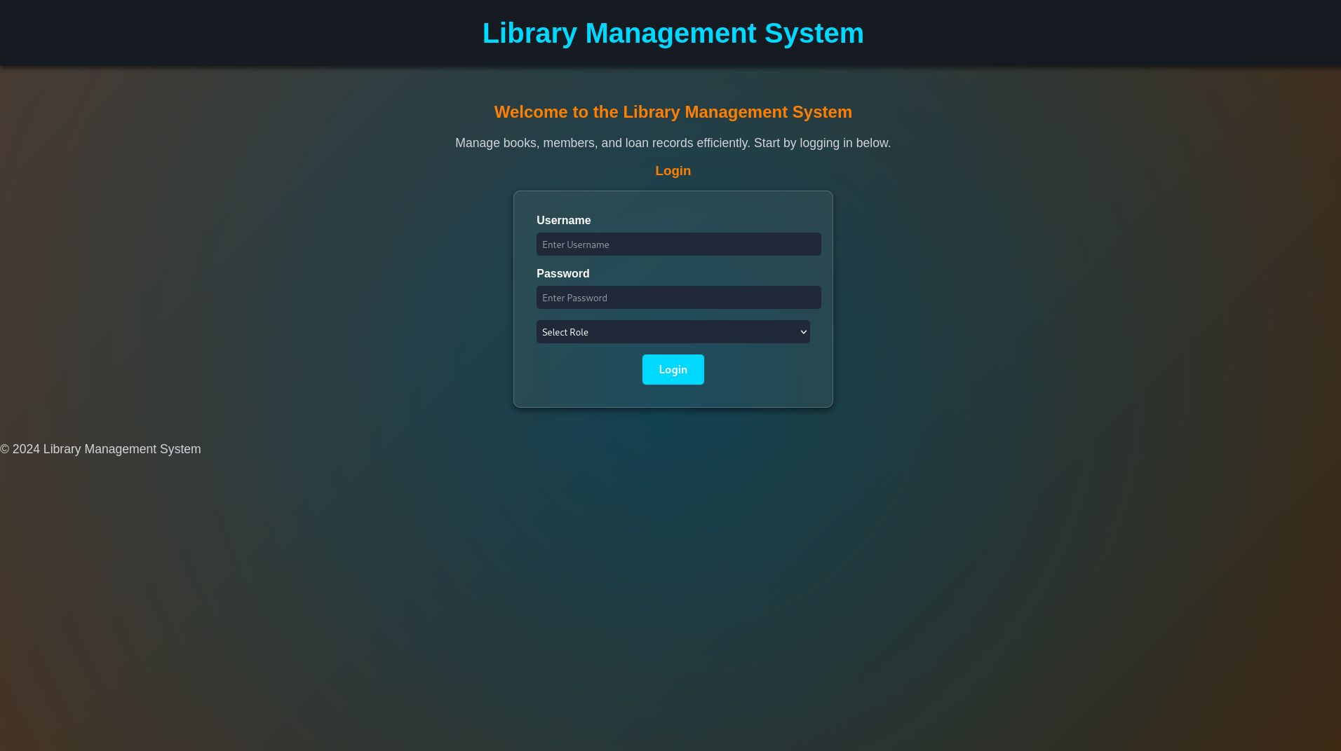
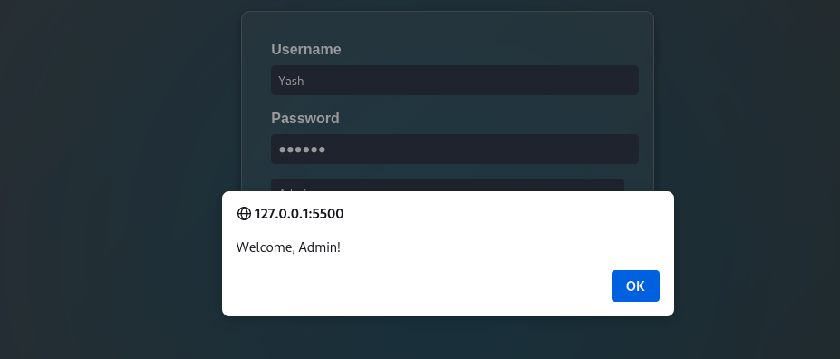
SCREENSHOTS OR DEMO TITLE

Slide 6
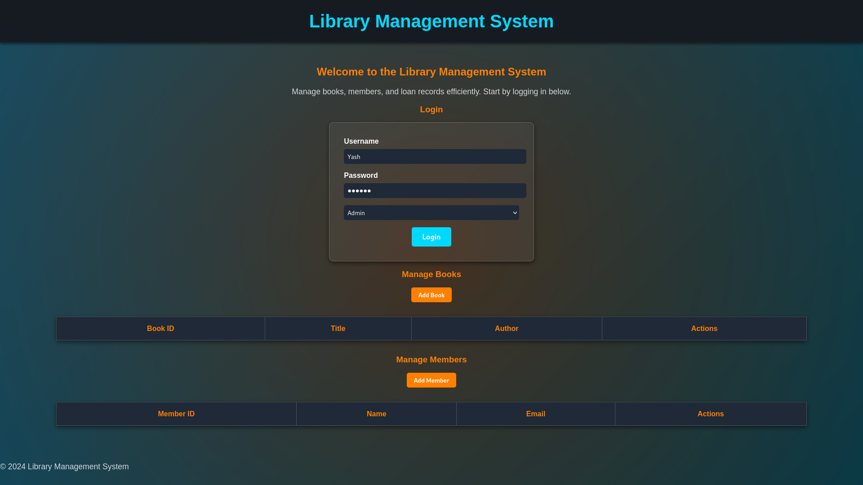

Slide 7
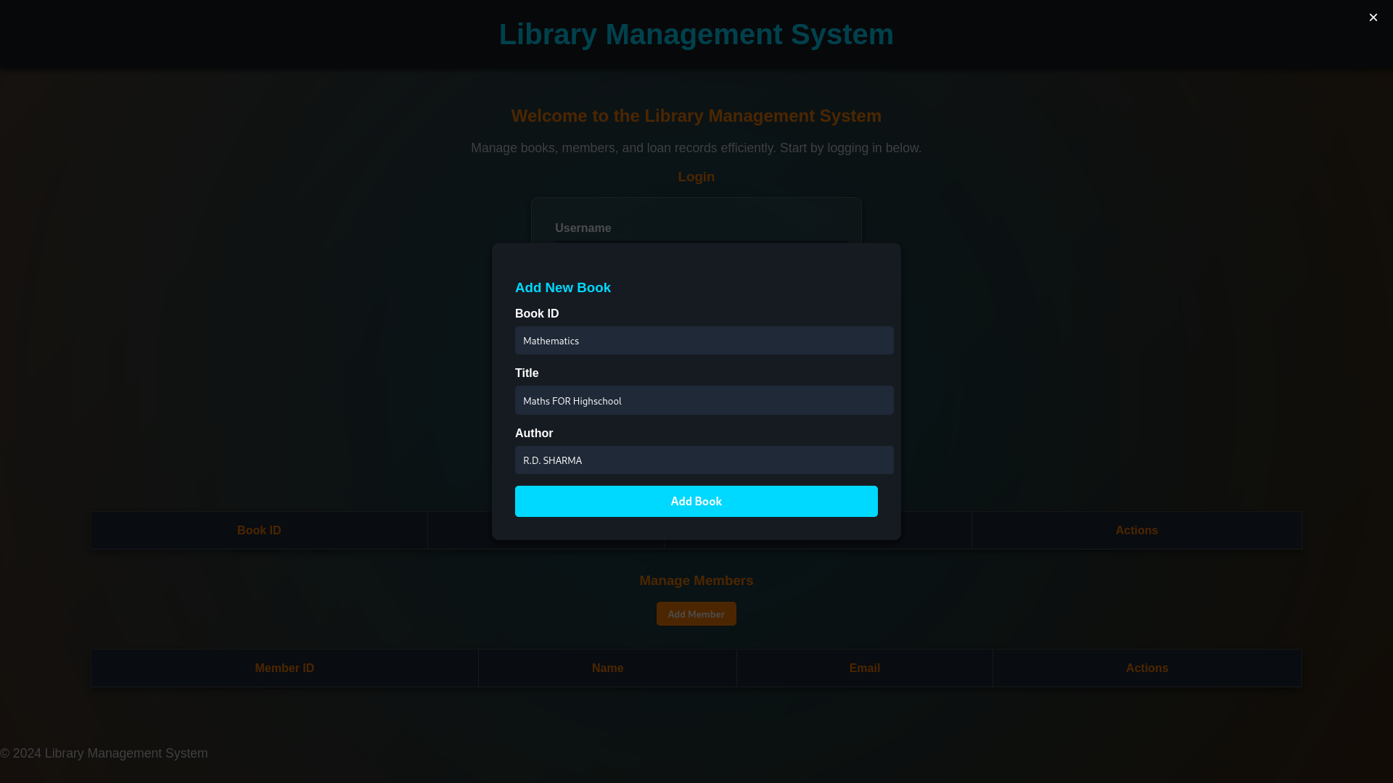

Slide 8
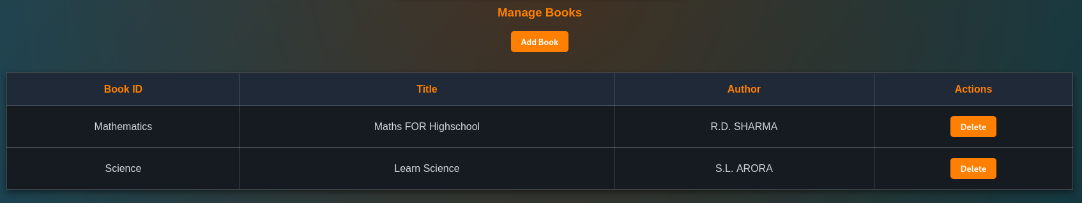

Slide 9
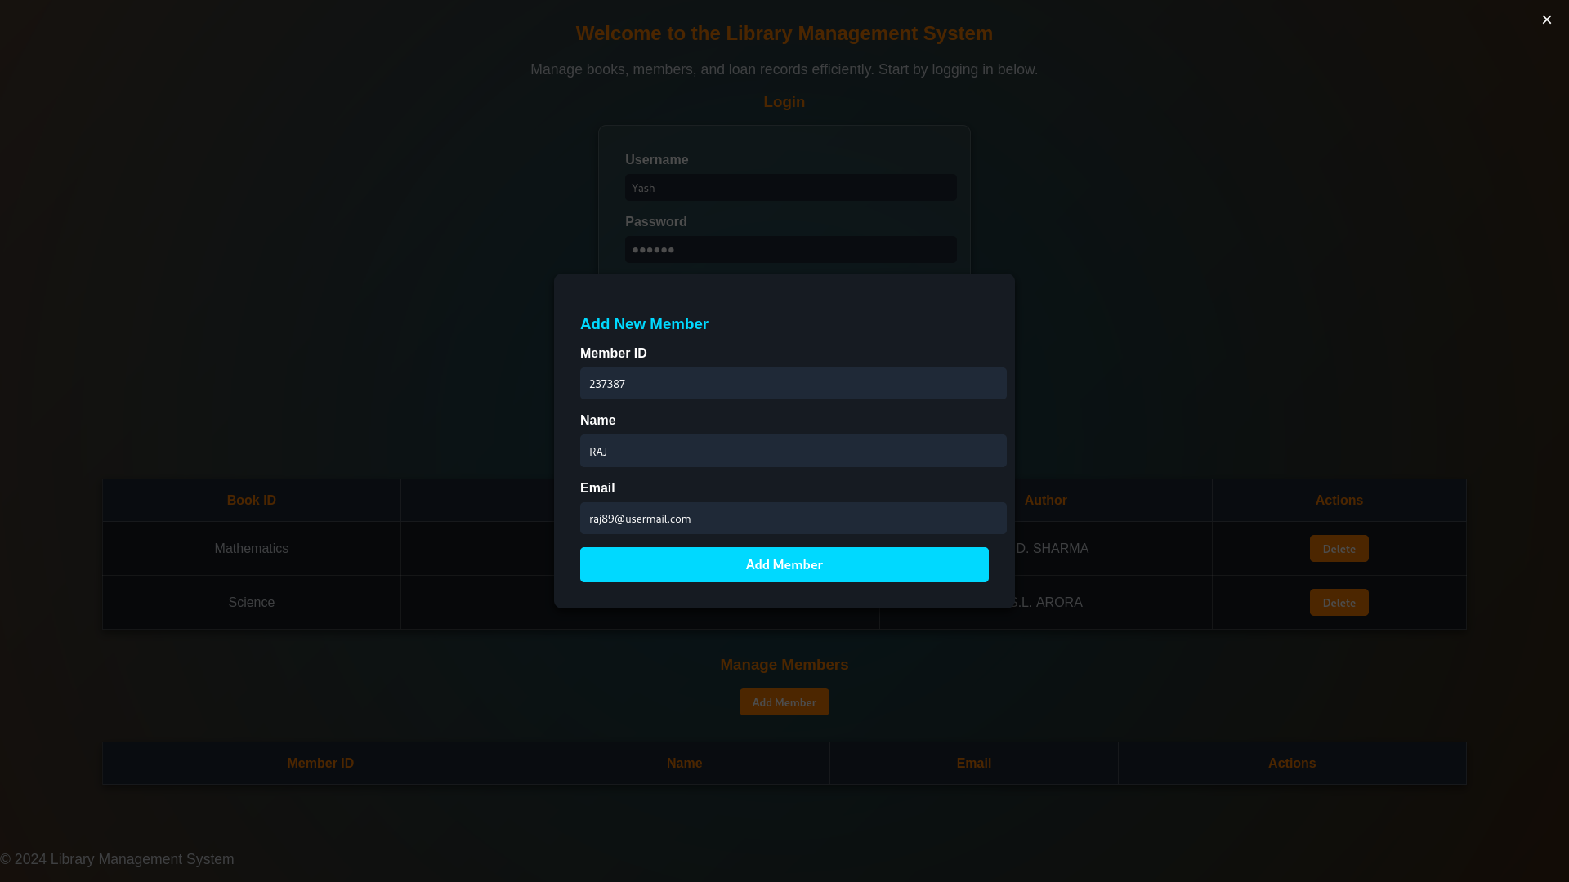

Slide 10
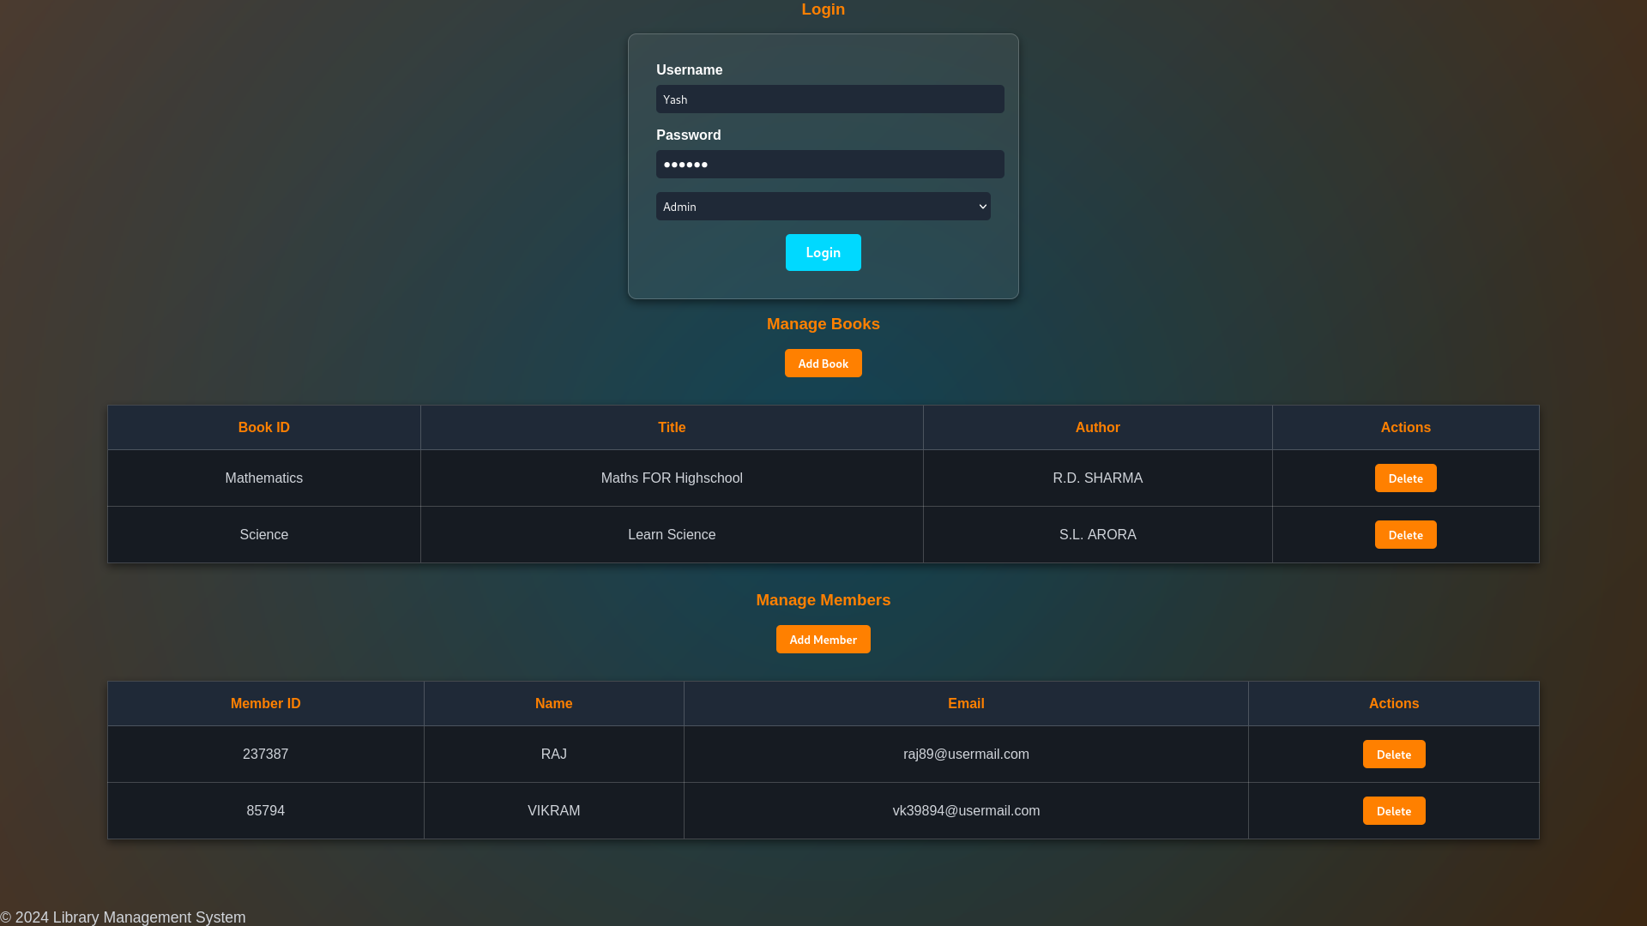

Slide 11
THANK YOU!

